Slide 1
Marketing Planning and Execution
Procedures
Promotion Response Model
October 2007

Slide 2
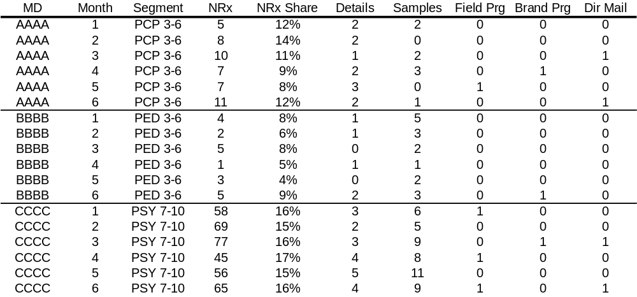
Data for Promotion Response model
- how does it look like
Time-Series Cross-Sectional data by time period (Month) and subject (MD). Data has to be balanced (equal # of time periods per subject)

Slide 3
Data Collection and Validation
Collect Rx data, by subject and time period, from PAR. The Rx data should include Nrx/Trx for both the Lilly product and the overall market. Calculate share of market.
Collect sales force activity data, details and field programs from md.raw_details file, and samples from md.raw_samples file. Make sure all relevant “calltype” and “prodgrp” codes are used for pulling detail and field program data, and “pharmprd” codes for pulling samples. The codes can be found in the “Metadata” folder on the Collaboration website.
Dedup field programs by personid and eventdate as multiple reps record the same MD for one program.
Pull field program “Program ID” from Dendrite and merge to field program data by “eventid”. Next download LLB data and merge to field program data by Program ID. Only those records that match to LLB represent field programs. The non-matching records represent details (rather than field programs) delivered during a field program for another product (e.g., Strattera detail during a Cymbalta field program). The topic field in LLB can be used to identify the topic of the field program.
Merge sales force activity data to md.bridge_file by personid to obtain affilid, affilsrc.
Merge Rx and sales force activity data by subject (affilid, affilsrc) and time period. Keep all subjects regardless of their Rx volume or sales force activity.
Collect decile, specialty, and segment (when relevant) data from PAR, and merge to the Rx/sales force activity data. Define MD segments for whom separate response curves will be needed. Usually, these are KPS as identified by the brand team. It is a good practice to develop the response models on a larger number of segments than KPS, and then summarize the response coefficients back to the KPS level, for example by individual deciles rather than by decile groups. This minimizes the bias in response coefficient estimates caused by pooling heterogeneous subjects together. Make sure though that there is a sufficient number of subjects per segment (usually several hundred) to obtain stable response coefficient estimates.

Slide 4
Data Collection and Validation … cont’d
H. Merge in qta.ttp_profile file to filter out MDs not in the quota pool. If alignment is needed, use the “crid” variable in the profile file to merge to md.terrid_hierarchy_quota file. During the merge, make sure that both files contain only records of the same “respcd” value.
I. Collect and merge in other (non-sales force) activity, brand programs, direct mail, and Rx pads from MMS or directly from the vendor, e-details and e-samples form e-Pharma, vouchers from Carol Butterfield, DTC from the Marketing Services Media group.
J. Cap the outliers
K. Subset data (10%) for model validation; for model build, use only subjects who received a certain level of promotional activity, i.e., at least one detail per quarter throughout the modeling time frame.
L. Collect and validate promotion cost, revenue forecast; align business strategy and budget constraints fro promotion mix optimization.
M. If payer access is used in the response model, collect payer data from the base layer of the US Answers.
N. If competitive data is used in the response model, collect it from Lilly PADDS.

Slide 5
Response Modeling Methodology
Response model estimates
  Incremental NRx Share due to MD level interventions
  Carryover of Incremental NRx Share that would occur without promotional effort
Mixed Model methodology is employed to estimate the response model
  Allows handling of correlation in MD behavior over time
  Allows variation in responsiveness of interventions by segment
    Segment definition is specific to the brand
    Segments could be based on brand team strategy, MD share behavior and attitude
  Possibility of estimating individual level responsiveness estimates while using information across the population (Bayesian shrinkage)

Slide 6
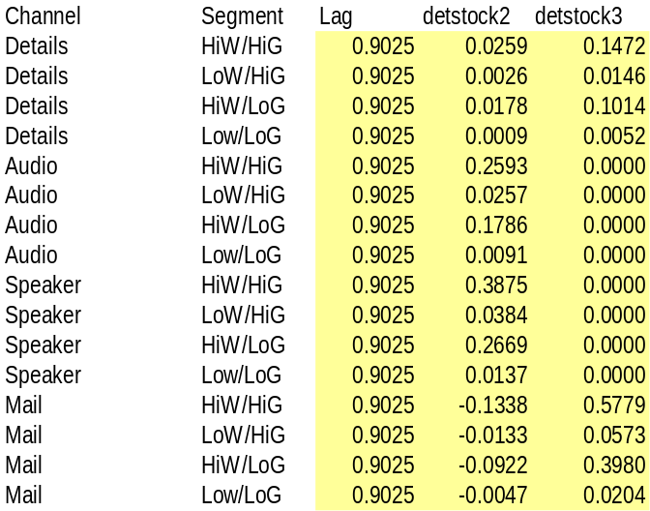
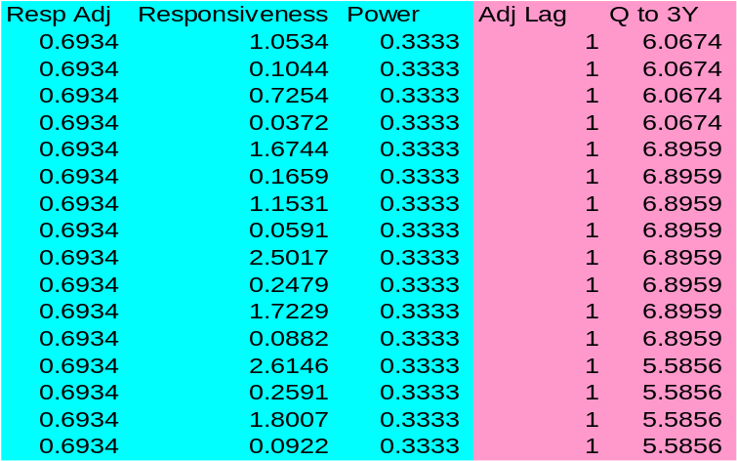
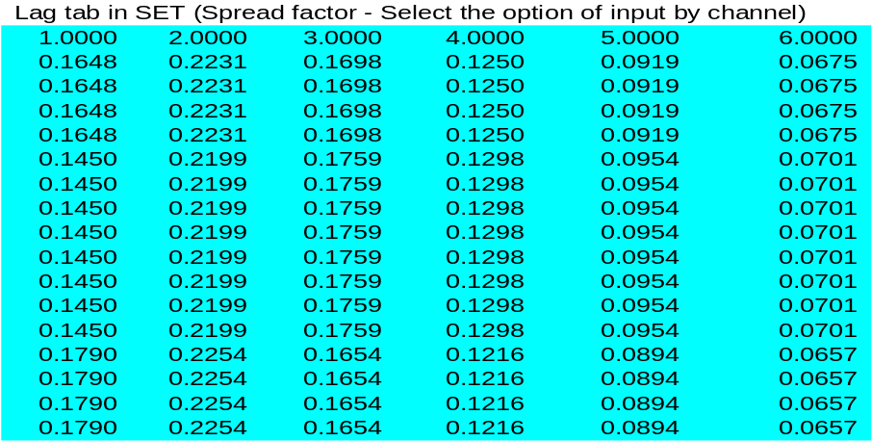
Response Model Output
PIL Response model output including carryover
(lag) estimate and detstock (betas) estimates by
channel and segment.
Using the Excel file named Brand_SET_input,
convert the model output into SET, promotion
mix tool for resource optimization. The tables
below show the SET input tables, including
response parameters with the adjustment factor,
predictor transformation power, carryover adjust-
ment and spread factor.

Slide 7
Carryover Estimation
Carryover is % of last period’s incremental sales due to marketing promotion that would reoccur in the next period without marketing interventions.
Two alternative response model lag structures may be used depending on the expected carryover pattern:
A) Conventional lag structure (Geometric decay)
B) Polynomial Inverse Distributed lag structure (PIL)

Slide 8
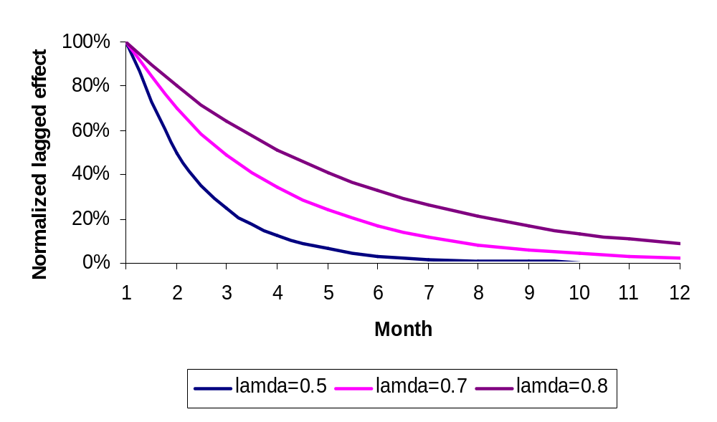
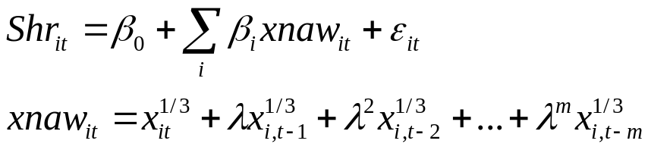
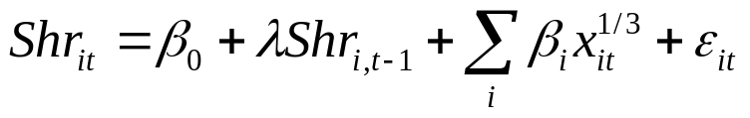
Conventional Lag Structure (Geometric Decay)
Estimation methods-NAW, Koyck
Assumes that the lagged effect is same for all channels
Assumes a geometric decay
Cannot handle the case of peak effect of promotion occurring in a period after the promotional period
NAW Method:
Involves constructing NAW (stock) variables
Involves grid search for the estimate of lamda
Assumes no effect after a specific period (m in this example)
Koyck Method:
Automatic estimation of lamda

Slide 9
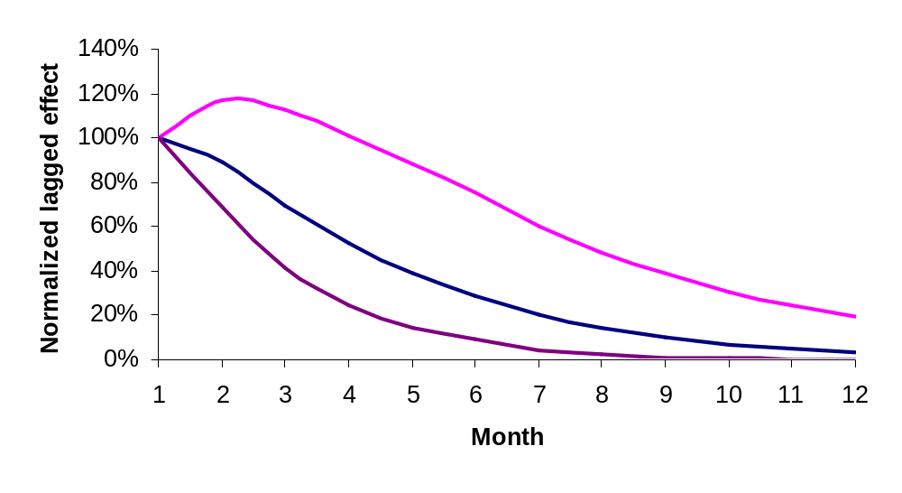

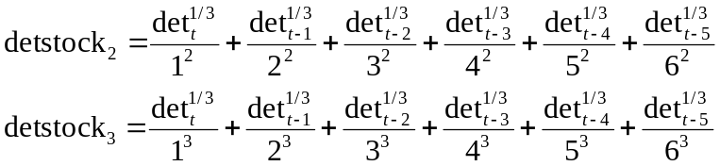
PIL (Polynomial Inverse Distributed Lag Structure)
Estimation methods-PIL
Can accommodate different lags for different channels
Does not assume a geometric decay
Can handle the case of peak effect of promotion occurring in a period after the promotional period
Regression model with lagged predictors
(Only details shown for illustration)
Lagged effects constrained to lie on a polynomial
Translates to working with two stock variables for details and estimating a regression on two parameters (α1 and α2)

Slide 10
Multicollinearity – How to address
Some of the marketing interventions in the model show a high degree of correlation, e.g., sales force details and free samples. The stock variables in the PIL model are highly correlated. Care must be taken to address multicollinearity to avoid model distortion and misleading results.
US Decision Science has employed 2 ways to address collinearity in the past
  Residual approach – This in some form was used in the past to address collinearity between details and samples
  SVD approach – This was tried when incorporating PIL (Polynomial inverse distributed lag) in the models introduced a much higher degree of collinearity between lagged variables

Slide 11


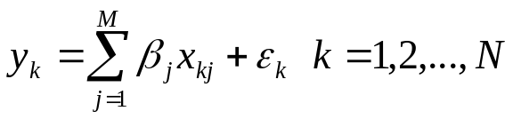

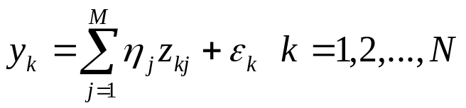
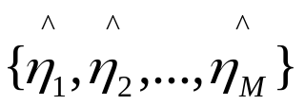
Basic Idea of the Approaches¹
0
Standardize the predictor variables to have mean 0 and variance 1
Consider a OLS model with M predictors and N observations:
Where the predictors exhibit a high degree of multicollinearity
Replace original predictors with new predictors (pseudo-predictors) that are uncorrelated
Assess the impact of pseudo-predictors on the dependent variable by running the following regression:
Suppose the estimates from this regression are given by:
1
2
Original predictors (correlated)
Pseduo predictors (un-correlated)
3
Reference:
1. Krishnamurthy. L. and Rangaswamy. A., The Equity Estimator for Market Research, Marketing Science, Vol 6., 1987, p336

Slide 12
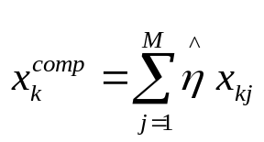


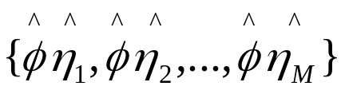
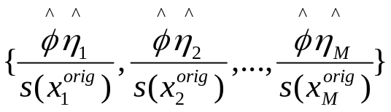
Basic Idea of the Approach (contd)
4
Assume that the relative impact of the original predictors is the same as the relative impact of the psuedo-predictors
Create a composite predictor variable based on this assumption
Estimate the impact of the composite variable on the dependent variable (This step can also be viewed as calibrating the dependent variable in terms of the original predictor variables)
Suppose the estimate is given by
The impact of standardized x variables on the dependent y variable is given by:
The impact of original x variables on the dependent y variable is given by dividing by the standard deviation of the original variables:
5
6
7

Slide 13
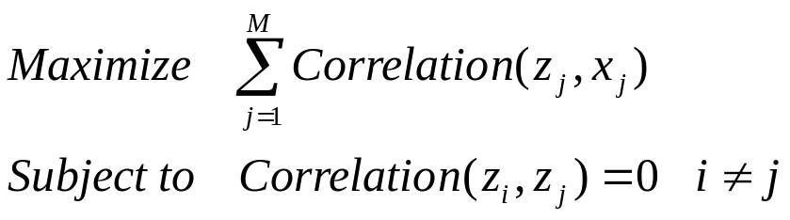
Pseudo-Predictors construction (SVD Method¹)
Basic idea of the method:
Create a set of uncorrelated variables that are as close as possible (in terms of correlation) to the original variables
Geometrical interpretation:
z₁
x₁
x₁
x₂
x₂
z₂
Reference:
1. Krishnamurthy. L. and Rangaswamy. A., The Equity Estimator for Market Research, Marketing Science, Vol 6., 1987, p336

Slide 14
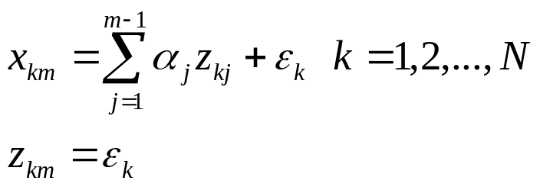
Pseudo-Predictors construction (Residual method)
Basic idea of the method:
Keep only the unique variation of the predictor variable that is not explained by other predictor variables
Psuedo-variable {z_{m}} is determined as the residual from regressing {x_{m}} on {z₁,z₂…z_{m-1}}
Geometrical interpretation:
x₁
z₁=x₁
z₂
x₂
x₂

Slide 15
Caveats of the approach
Assumption/Judgment driven construction of pseudo-predictors
Hard to estimate standard error and covariance of parameter estimates
Indicator variables might be difficult to handle with this approach
Approach more suited to response models created separately for each group (using by statements)

Slide 16
Appendix
Data collection and validation : SAS program flow
Response model: SAS program flow
Technical details of creating pseudo predictors .. SAS code

Slide 17
Data Collection and Validation
SAS program flow
01_xporxmnth.sas … collect the Rx data
02_getdetsmp.sas … collect sales force detail and sample data
03_getfieldprog.sas … collect sales force field program data, merge in program id from Dendrite, merge with LLB data
04_getmduniv_v2.sas … pull the base MD universe from the qta.ttp_profile file, merge with specialty and decile data from PAR
04_getpyrindex.sas … pull in the payer index data (currently residing on salam.mkt_paymain data; the raw Plantrak data sits in the base layer in US Answers)
06_getbrndprog_dwa.sas, 06_getbrndprog_v0.2.sas … pull the brand program data from MMS
06_getesample.sas … collect e-sample data
06_getgrp.sas … collect GRP data for TV advertising; the raw data can be obtained from the Marketing Services Media group (Joe Holman, Amanda Kleiman)
06_getmail.sas … collect direct mail data from MMS
06_getrxpads.sas … collect Rx pads data from MMS

Slide 18
Data Collection and Validation
SAS program flow
K. 06_getvouchers.sas … pull in voucher data (obtained from Carol Butterfield in US Strategic Pricing)
L. 06_getallact.sas … pull together all marketing activity data as identified above, including sales force activity
M. 07_getmdlddata_mdd.sas … merge Rx and activity data together, prepare the data to be run through SAS proc mixed
N. 07_rchfreq_mdldata_v0.1.sas … create reach/frequency summaries from the modeling data set for input into the SET tool

Slide 19
Mixed Model
SAS program flow
getzvar_by.sas, rpttxt.sas … macros; used to convert the original set of variables to the new set of uncorrelated variables, … see page 12 for explanation.
070407_respmdl_geometric_v.0.1.sas … mixed model code with geometric decay pattern
070407_respmdl_pil_v0.1.sas … mixed model code with polynomial inverse lag decay pattern

Slide 20
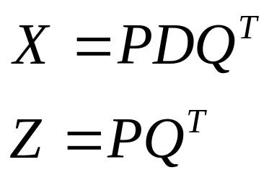
SAS code/Technical details of creating pseudo-predictors – SVD Method
SAS Macro
%getvar_by(inds=tempin,outds=tempout,byvar=segment,pcvar=%str(det smp prog)) ;
* inds - Input dataset ;
* outds - Output dataset ;
* byvar - By group variables ;
* pcvar - Variables for which Z matrix needs to be created ;
* z variables are stored under the name of pcvar2 ;
Technical Details of constructing Z variables
Singular value decomposition (SVD) of X
Reference:
1. Krishnamurthy. L. and Rangaswamy. A., The Equity Estimator for Market Research, Marketing Science, Vol 6., 1987, p336

Slide 21
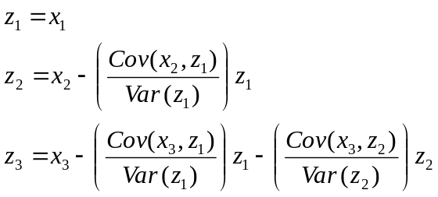

SAS code/Technical details of creating pseudo-predictors – Residual Method
SAS Macro
%getgsvar_by(inds=tmpinput,outds=tmpoutput,seg=dummy,xvar=%str(det smp prog)) ;
* inds - Input data set ;
* outds - Output data set ;
* seg - Segment variable (always needed) ;
* xvar - List of X variables that need to be made uncorrelated
This needs to be specified within the %str function - see example ;
* The output variables have the same name as input variables prefixed with res ;
Technical Details of constructing Z variables
…

